Slide 1
TravelNow
TravelNow
Group 7 :
Christian Frans Mukuan
Deyaninta Ekabriela Permata
Mufadhal Faraz Addhifa
Notes:
Good Morning, Everyone!
Today, we are going to presentate our project.
And let us introduce ourselves.

Slide 2


Slide 3

Agenda
01
What is TRAVELNOW ?
02
What is Database?
03
ERD of TRAVELNOW
04
Schemas Diagram of TRAVELNOW
Notes:
Ok, this is our agenda

Slide 4
What is TRAVELNOW?
Notes:
What is travel now?

Slide 5
Flight
Hotel
Tour
Transportation
Tour Guide
Notes:
TravelNow is an Startup company from Indonesia that provides flight, hotel, tour, transportation booking services that are complemented by tour guide services to accompany customers on National or International Holidays. For now, TravelNow still focuses on travel in Asian countries only. With us, customers can explore many countries easier. The exploration time will be more fun with our tour guide. Price that we offer is pretty far from the words "expensive".

Slide 6
What is Database?
Notes:
A database is an organized collection of structured information, or data, typically stored electronically in a computer system. A database is usually controlled by a database management system (DBMS). Together, the data and the DBMS, along with the applications that are associated with them, are referred to as a database system, often shortened to just database. Data within the most common types of databases in operation today is typically modeled in rows and columns in a series of tables to make processing and data querying efficient. The data can then be easily accessed, managed, modified, updated, controlled, and organized. Most databases use structured query language (SQL) for writing and querying data

Slide 7
Diagram Schemas
of Database

Slide 8
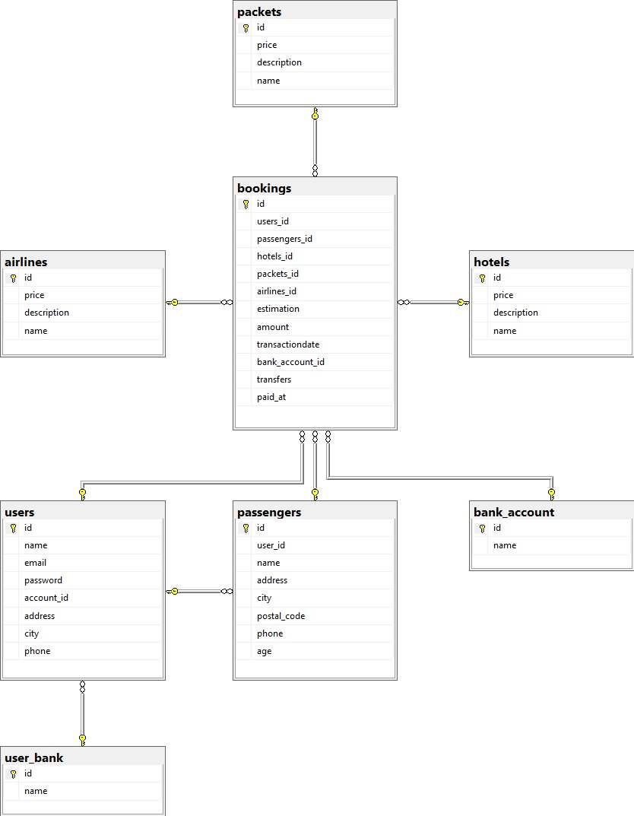
Notes:
This is the schemas diagram of TravelNow

Slide 9
Thank you
Any Question?

